Slide 1

Service Insights
Learning Cluster
Data Visualization
December 9, 2020
Notes:
{Renee will mute attendees upon entry & record the meeting}
{ask Renee to keep track of unanswered questions in the chat for the Q&A time}
Hello and welcome to the next learning cluster meeting! {next slide}

Slide 2
Housekeeping
We’re recording!
Microphones muted upon entry
Unmute yourself to comment or ask a question
Can also use the Q&A box on Webex

Slide 3
Agenda
Welcome
Why Use Data Visualization?
Selecting the Right Visualization Tool
Q&A / Discussion
Wrap Up

Slide 4
Introductions
Facilitator
Amber Lee, Director, Data Analyst, All Faiths Food Bank (Sarasota, FL)
Guest Presenters
Regis Whaley, Director of Business Support, Three Square Food Bank (Las Vegas, NV)
Amanda Benson, Client Voice Project Manager, Alameda County Community Food Bank (Oakland, CA)
Cam Denney, Research Analyst, Alameda County Community Food Bank (Oakland, CA)

Slide 5
Poll Question #1
What tools do you use for Data Visualization?
Tableau
Jet Reports
PowerPivot/Excel
Other
A combination of tools
We haven’t begun using visualization tools for our data

Slide 6
Operate Phase – Objectives and Outcome
Clean data
Monitor agencies and follow-up
Use and share data
System modifications
System maintenance
System enhancements
Evaluate program and implementation

Slide 7

Why use data visualization?
Answer a question
Identify changes over time
Determine frequency
Determine relationships (correlations)
Examine a network
Scheduling
Analyze value and risk
Tell a story or inspire
Strategic decision-making

Slide 8
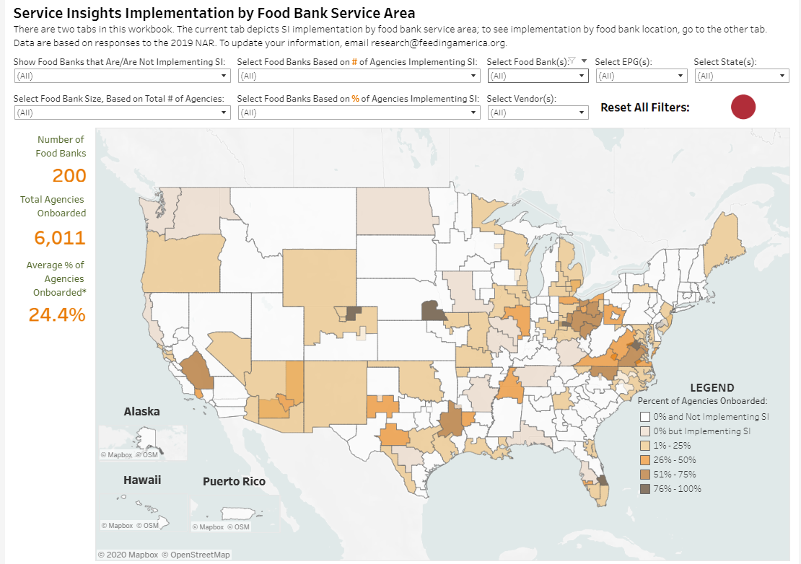
Utilizing data visualizations to share insights can be:
Complex and interactive, or
Example: DT Oliver, Feeding America

Slide 9
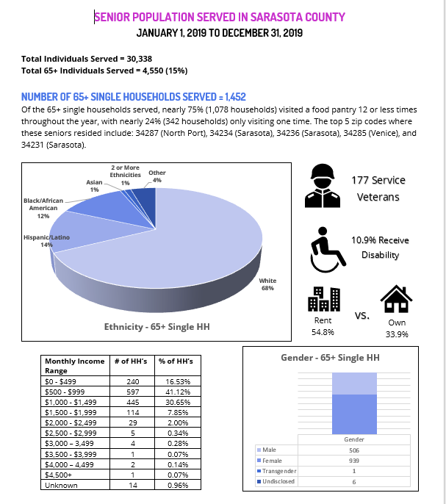
Utilizing data visualizations to share insights can be:
Basic and static

Slide 10
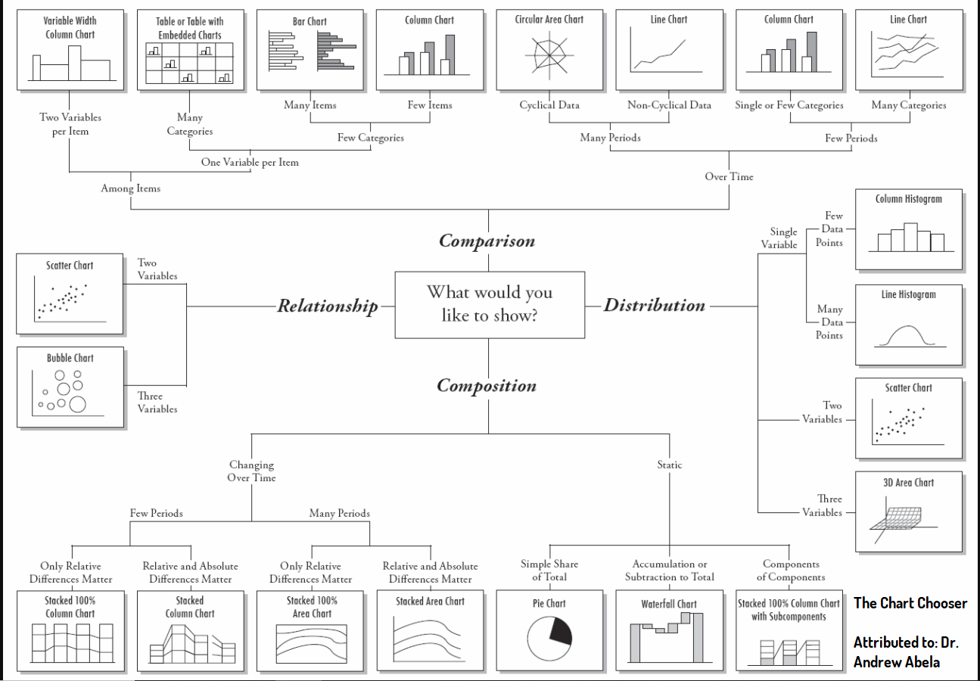
What’s the right messaging tool?
Presenting distribution
Visualizing compositions
Showing relationships
Indicating trends
Comparison

Slide 11

Regis Whaley
Three Square Food Bank, Las Vegas, NV
Service Insights Technology: Oasis Insight

Slide 12

Service Insights at Three Square
Started off as a grant-funded effort through the state of Nevada in July 2019
Also being supported by Service Insights funding from Feeding America (thank you!)
Currently engaging in course correction ☺

Slide 13
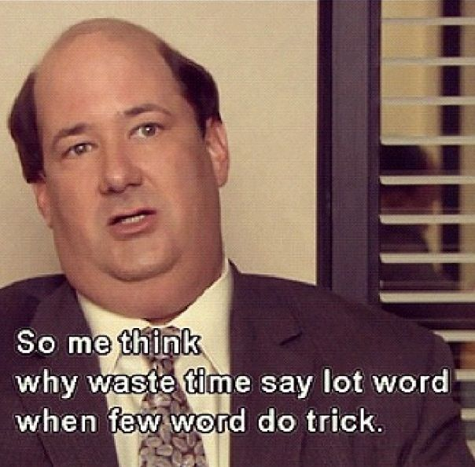
Today’s Visualization: Administrative Data
What questions does this viz answer?
How many agencies are using Oasis Insight? How many users?
What does the general activity of the Oasis Insight network look like currently? How many households, cases, assistances?
What are some other useful metrics can be derived from our Service Insights data?
Key takeaways
Data visualization is the fun part!
Data visualization isn’t necessarily complicated.
A few words can make a big difference with visualization.

Slide 14

Cam Denney & Amanda Benson
Alameda County Community Food Bank, Oakland, CA
Service Insights Technology: Oasis Insight

Slide 15
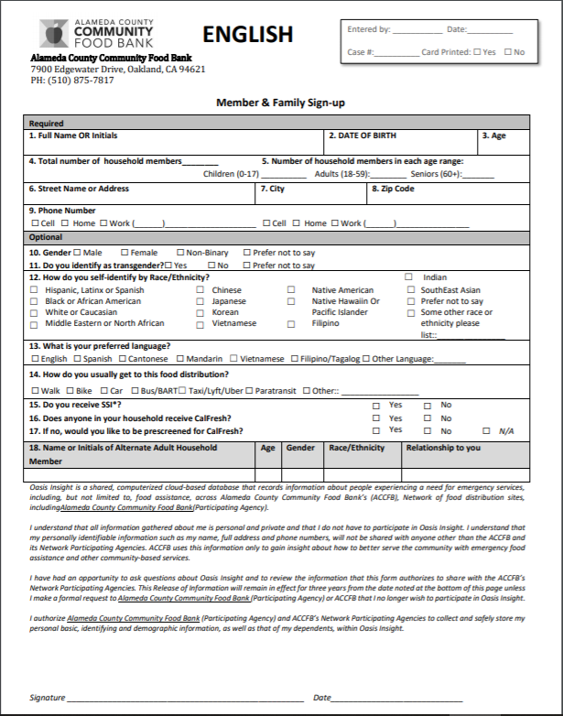
ACCFB Service Insights
Overview: Client Voice/Service Insights
First agencies on-boarded 2 years ago
Demographics Collected Currently
Network Data Glossary
Current Network Map
Currently have 17 agencies that have trained into Client Voice/Service Insights
See map

Slide 16
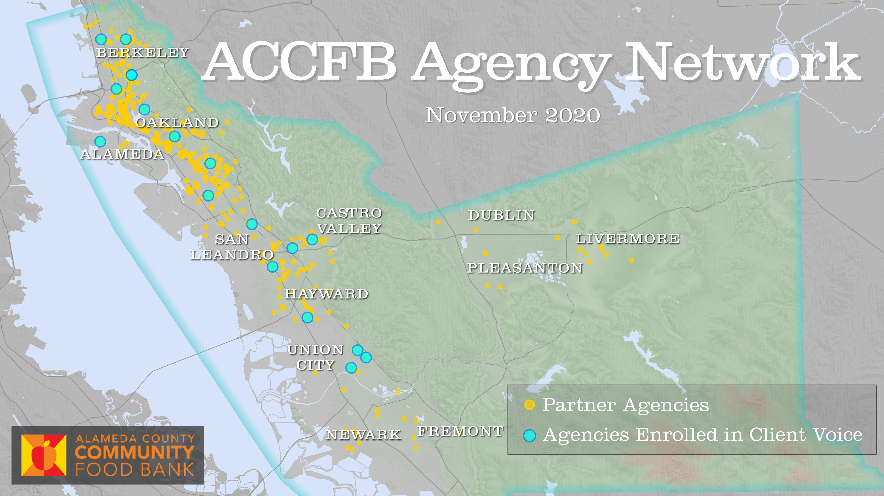
ACCFB Network Map

Slide 17
Data Visualizations
Tableau
Data set covers FY2020 (July 2019 through June 2020)
Data has gaps starting in March when several agencies stopped reporting
Over 18,000 clients
Representing 15 agencies
Tableau Data Visualization
Other Visualizations
Working on a new monthly report visualization using R and excel
Next steps: Service Trends over time

Slide 18
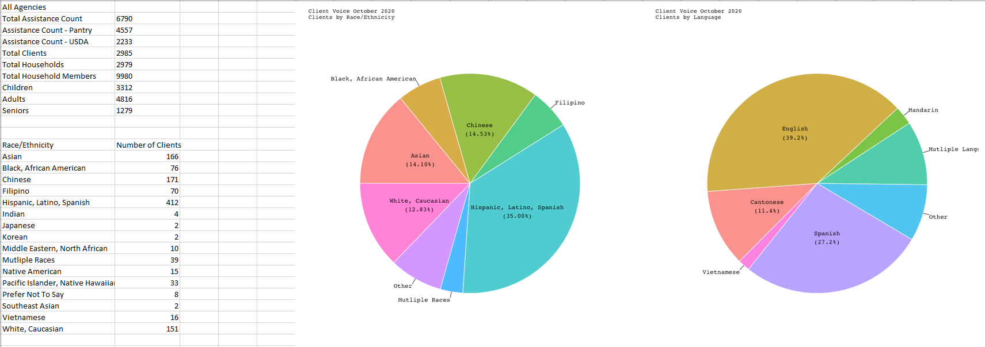
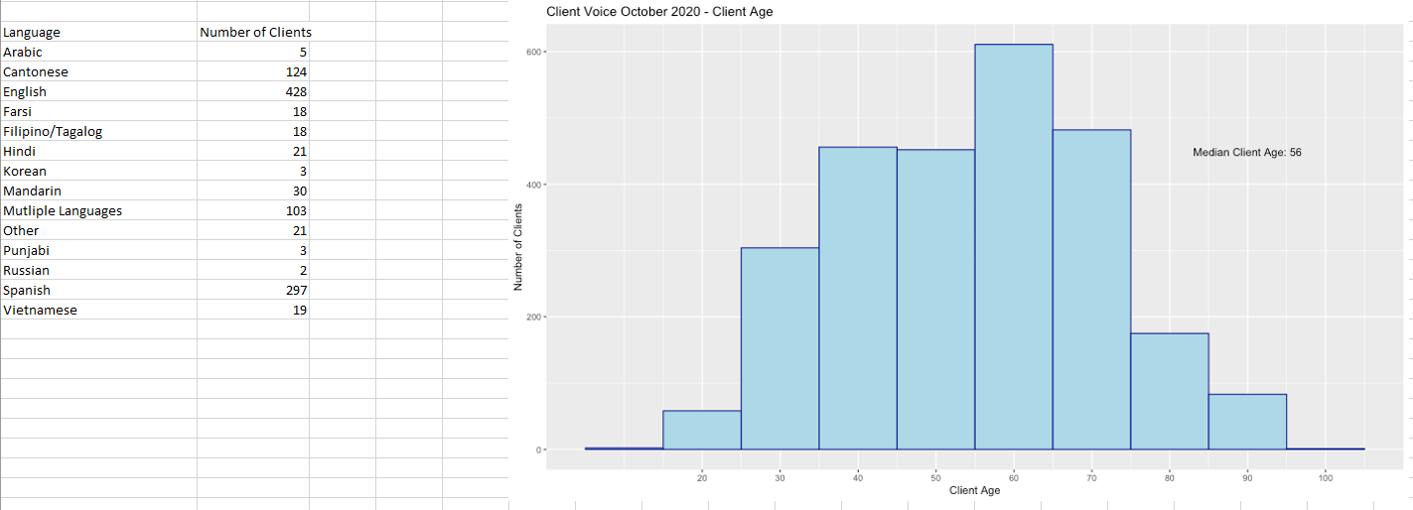

Slide 19

Contact Information
Amanda Benson Client Voice Project Manager abenson@accfb.org
Regis Whaley Director of Business Support rwhaley@ThreeSquare.org
Cam Denney
Research Analyst
cdenney@accfb.org
Amber Lee Director, Data Analyst alee@allfaithsfoodbank.org

Slide 20

Discussion and Q&A

Slide 21
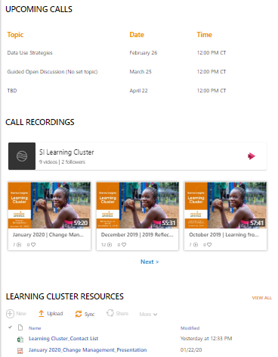
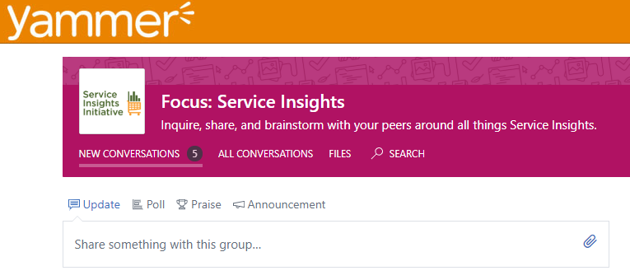
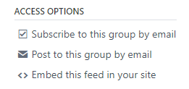
Reminder: Peer Learning Group Spaces on HungerNet & Yammer
HungerNet
Yammer
Subscribe to
posts by email

Slide 22
Next Meeting
Wednesday, January 27 @ 12:00 PM CT
Topic: Choosing the right data elements: SI Network Data Glossary Updates & Disc​​​ussion
Facilitator: Jaclyn Tekiela
Email Renee Vuillaume at rvuillaume@feedingamerica.org to be added to the email list
Notes:
February call topic is SI in a mobile setting

